Slide 1
Self-Supervised Learning Word Representations
CSCI 601 471/671
NLP: Self-Supervised Models
https://self-supervised.cs.jhu.edu/sp2023/
[Slide credit: Chris Manning, John Canny, Reda Bouadjenek, and many others ]

Slide 2
HW Poll
How was it?
A note about solutions:
We will not release solutions.
But we will be as clear as we can in our grading.
If there are any lingering questions about homework solutions, come discuss during office hours.

Slide 3
Recap
Inherently, there is no meaning to symbols:
Lots of literature on mapping symbols to their "meaning” (e.g., formal semantics)
Focus of this class: distributional semantics —learning some meaning by regurgitating language use.
Simplest form: learning word representations via Word2Vec
”apple” ≈ 0110000101110000011100000110110001100101

Slide 4
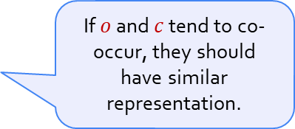



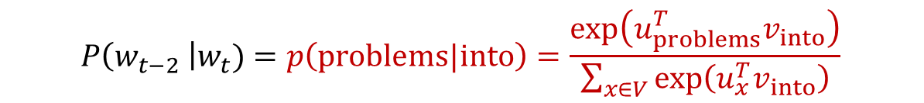


Recap: Word2Vec Probabilities
If $o$ and $c$ tend to co-occur, they should have similar representation.
$$P\left(o\right|c)=\frac{\exp\left(u_{o}^{T}v_{c}\right)}{\sum_{x∈V}{\exp\left(u_{x}^{T}v_{c}\right)}}$$
$$P\left(w_{t−2} \right|w_{t})=p\left(problems|into\right)=\frac{\exp\left(u_{problems}^{T}v_{into}\right)}{\sum_{x∈V}{\exp\left(u_{x}^{T}v_{into}\right)}}$$
$$P\left(w_{t−2} \right|w_{t})$$
$$P\left(w_{t+2} \right|w_{t})$$
$$P\left(w_{t−1} \right|w_{t})$$
$$P\left(w_{t+1} \right|w_{t})$$
…
problems
turning
into
banking
crises
as
…
outside context words center word outside context words in window of size 2 at position t in window of size 2

Slide 5

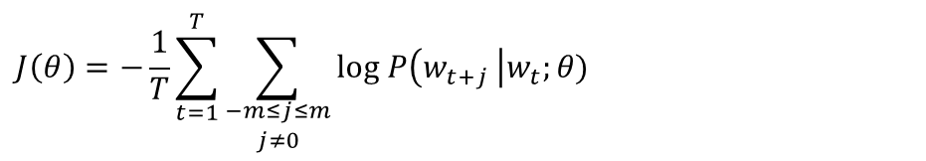

Recap: Word2Vec Objective Function
Minimize the objective function (log-likelihood) via Gradient Descent.
Derivatives of “center” vectors:
Derivatives of “outside” vectors:
$$J\left(θ\right)=−\frac{1}{T}\sum_{t=1}^{T}{\sum_{\begin{aligned}−m≤j≤m \\ j≠0\end{aligned}}{log P\left(w_{t+j} \right|w_{t};θ)}}$$
text length
window size
$$\frac{∂}{∂v_{c}}J\left(θ\right)= ?$$
We will derive the gradients with respect to the ”center” vectors. Similar calculations for “outside” vectors (homework!!)
$$\frac{∂}{∂u_{c}}J\left(θ\right)= ?$$

Slide 6
Chapter: Self-Supervised Meaning of “Words”: Continued
Human language and word meaning
Word2vec overview
Word2vec objective function and gradients
Inspecting the resulting word vectors
Extrinsic evaluation of word vectors

Slide 7
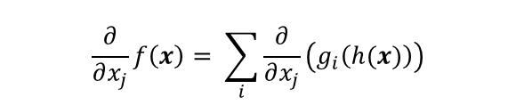
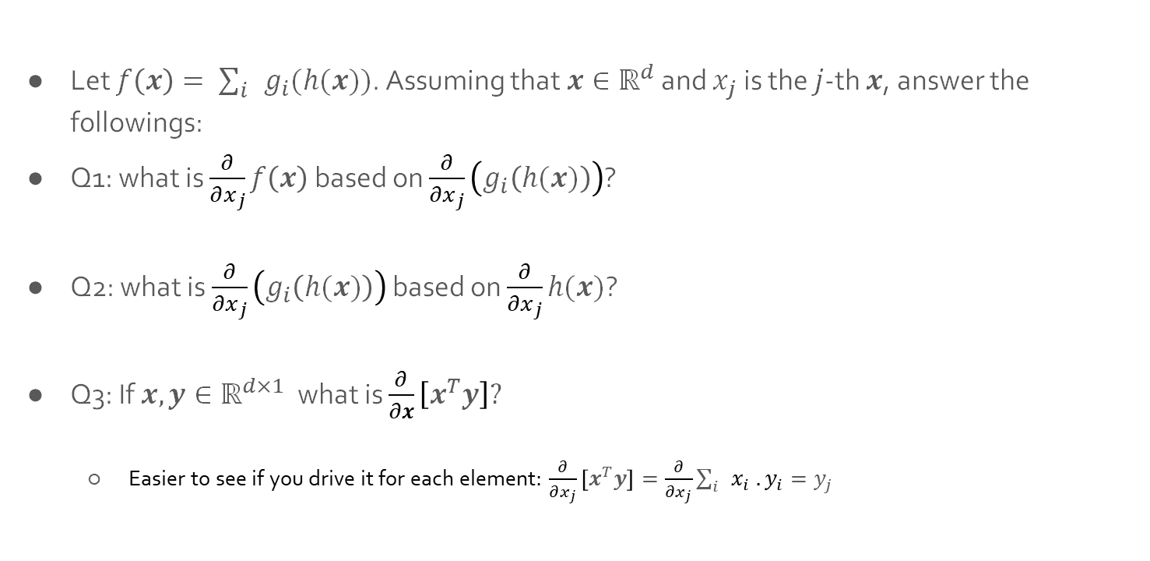


Linear Algebra Pop Quiz
Let $f\left(x\right)= \sum_{i}{g_{i}(h(x))}$. Assuming that $x∈ℝ^{d}$ and $x_{j}$ is the $j$-th $x$, answer the followings:
Q1: what is $\frac{∂}{∂x_{j}}f\left(x\right)$ based on $\frac{∂}{∂x_{j}}\left(g_{i}\left(h(x)\right)\right)$?
Q2: what is $\frac{∂}{∂x_{j}}\left(g_{i}\left(h(x)\right)\right)$ based on $\frac{∂}{∂x_{j}}h(x)$?
Q3: If $x, y∈ℝ^{d×1}$ what is $\frac{∂}{∂x}\left[x^{T}y\right]?$
Easier to see if you drive it for each element: $\frac{∂}{∂x_{j}}\left[x^{T}y\right]=\frac{∂}{∂x_{j}}\sum_{i}{x_{i} . y_{i}}=y_{j}$
$$\frac{∂}{∂x_{j}}f\left(x\right)= \sum_{i}{\frac{∂}{∂x_{j}}\left(g_{i}\left(h(x)\right)\right)}$$
(distributive property)
$$\frac{∂}{∂x_{j}}\left(g_{i}\left(h(x)\right)\right)=g_{i}^{′}\left(h(x)\right) ×h^{′}(x)$$
(chain rule)
$$\frac{∂}{∂x}\left[x^{T}y\right]=y$$

Slide 8
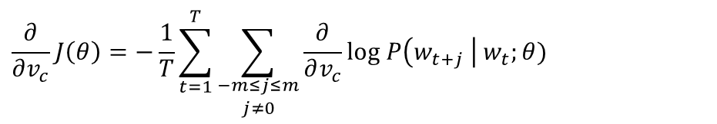
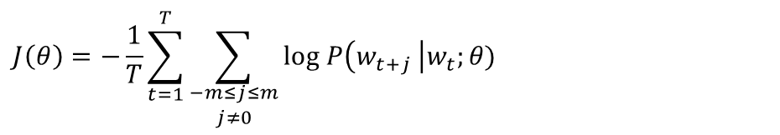

Computing the Gradients for Word2Vec
Minimize the objective function (log-likelihood):
$$J\left(θ\right)=−\frac{1}{T}\sum_{t=1}^{T}{\sum_{\begin{aligned}−m≤j≤m \\ j≠0\end{aligned}}{log P\left(w_{t+j} \right|w_{t};θ)}}$$
text length
window size
$$\frac{∂}{∂v_{c}}J\left(θ\right)=−\frac{1}{T}\sum_{t=1}^{T}{\sum_{\begin{aligned}−m≤j≤m \\ j≠0\end{aligned}}{\frac{∂}{∂v_{c}}log P\left(w_{t+j} \right| w_{t};θ)}}$$
(distributive property)
$$?$$

Slide 9


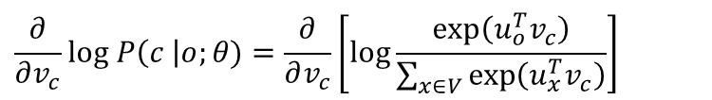



Computing the Gradients for Word2Vec (2)
$$P\left(o \right| c)$$
into
banking
$v_{c}$ $u_{o}$
$$\frac{∂}{∂v_{c}}log P\left(c \right|o;θ)=\frac{∂}{∂v_{c}}\left[log\frac{\exp\left(u_{o}^{T}v_{c}\right)}{\sum_{x∈V}{\exp\left(u_{x}^{T}v_{c}\right)}}\right]$$
$$=\frac{∂}{∂v_{c}}\left[\log{\exp\left(u_{o}^{T}v_{c}\right)− }\log{\sum_{x∈V}{\exp\left(u_{x}^{T}v_{c}\right)}}\right]$$
$$=\frac{∂}{∂v_{c}}\left[\log{\exp\left(u_{o}^{T}v_{c}\right)}\right]−\frac{∂}{∂v_{c}}\left[\log{\sum_{x∈V}{\exp\left(u_{x}^{T}v_{c}\right)}} \right]$$
(distributive property)
$$\frac{∂}{∂v_{c}}\left[\log{\exp\left(u_{o}^{T}v_{c}\right)}\right]=\frac{∂}{∂v_{c}}\left[u_{o}^{T}v_{c}\right]=u_{o}$$

Slide 10



Computing the Gradients for Word2Vec (3)
$$P\left(o \right| c)$$
into
banking
$v_{c}$ $u_{o}$
$$\frac{∂}{∂v_{c}}log P\left(c \right|o;θ)=\frac{∂}{∂v_{c}}\left[log\frac{\exp\left(u_{o}^{T}v_{c}\right)}{\sum_{x∈V}{\exp\left(u_{x}^{T}v_{c}\right)}}\right]$$
$$=\frac{∂}{∂v_{c}}\left[\log{\exp\left(u_{o}^{T}v_{c}\right)− }\log{\sum_{x∈V}{\exp\left(u_{x}^{T}v_{c}\right)}}\right]$$
$$=\frac{∂}{∂v_{c}}\left[\log{\exp\left(u_{o}^{T}v_{c}\right)}\right]−\frac{∂}{∂v_{c}}\left[\log{\sum_{x∈V}{\exp\left(u_{x}^{T}v_{c}\right)}} \right]$$
(distributive property)
$$?$$

Slide 11

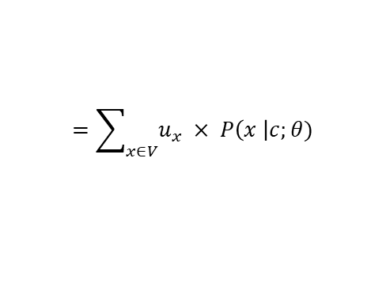

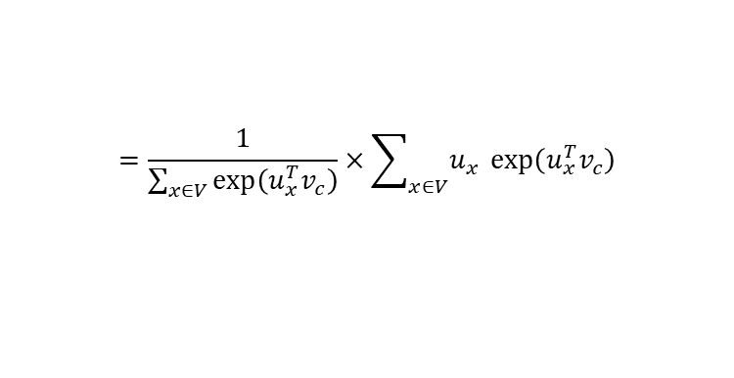
Computing the Gradients for Word2Vec (4)
$$P\left(o \right| c)$$
into
banking
$v_{c}$ $u_{o}$
$$\frac{∂}{∂v_{c}}\left[\log{\sum_{x∈V}{\exp\left(u_{x}^{T}v_{c}\right)}} \right]=\frac{1}{\sum_{x∈V}{\exp\left(u_{x}^{T}v_{c}\right)}}×\frac{∂}{∂v_{c}}\sum_{x∈V}{\exp\left(u_{x}^{T}v_{c}\right)}$$
$\frac{∂}{∂x}\log\left(f(x)\right)=\frac{1}{f(x)}\frac{∂f}{∂x}$
$$=\frac{1}{\sum_{x∈V}{\exp\left(u_{x}^{T}v_{c}\right)}}×\sum_{x∈V}{u_{x} \exp\left(u_{x}^{T}v_{c}\right)}$$
$$\frac{∂}{∂x}\exp\left(f(x)\right)=\frac{∂f}{∂x} × exp\left(f(x)\right)$$
$$=\sum_{x∈V}{u_{x} × P\left(x \right|c;θ) }$$

Slide 12
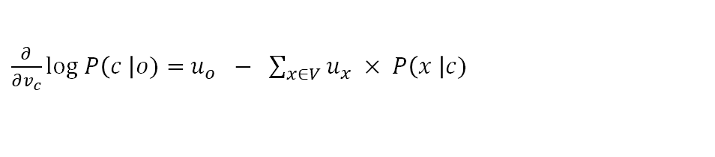


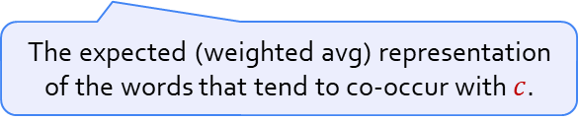
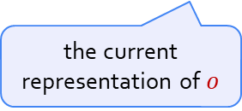
Computing the Gradients for Word2Vec (5)
$$P\left(o \right| c)$$
into
banking
$v_{c}$ $u_{o}$
Putting things together:
Intuition: This gradient incentivizes representation of $o$ to be more similar to the avg representation of words co-occurring with $c$.
$\frac{∂}{∂v_{c}}log P\left(c \right|o)=$ $u_{o} − \sum_{x∈V}{u_{x} × P\left(x \right|c) }$
the current representation of $o$
The expected (weighted avg) representation of the words that tend to co-occur with $c$.

Slide 13
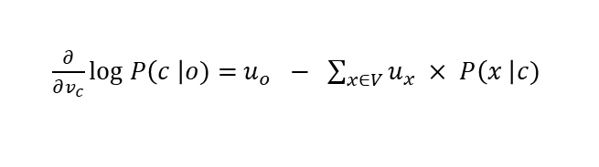

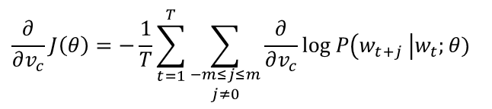
Pop Quiz
What is the computational complexity of the followings? (assume that $P\left(o\right|c)$ is pre-computed we just need to look it up)
$$\frac{∂}{∂v_{c}}J\left(θ\right)=−\frac{1}{T}\sum_{t=1}^{T}{\sum_{\begin{aligned}−m≤j≤m \\ j≠0\end{aligned}}{\frac{∂}{∂v_{c}}log P\left(w_{t+j} \right|w_{t};θ)}}$$
$\frac{∂}{∂v_{c}}log P\left(c \right|o)=$ $u_{o} − \sum_{x∈V}{u_{x} × P\left(x \right|c) }$
O(d)
O(|V|)
O(|V|+d)
O(|V|.d)
O(T)
O(T.m)
O(T.m.|V|)
O(T.m.|V|.d)

Slide 14
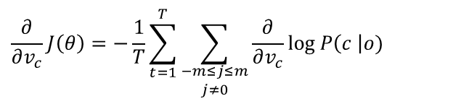
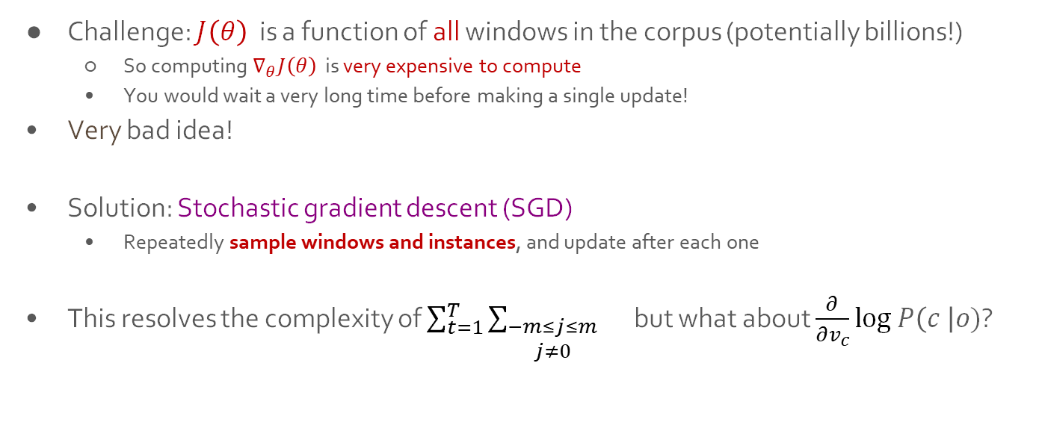
Stochastic Gradient Descent
Challenge: $J\left(θ\right)$is a function of all windows in the corpus (potentially billions!)
So computing $∇_{θ}J\left(θ\right)$ is very expensive to compute
You would wait a very long time before making a single update!
Very bad idea!
Solution: Stochastic gradient descent (SGD)
Repeatedly sample windows and instances, and update after each one
This resolves the complexity of $\sum_{t=1}^{T}{\sum_{\begin{aligned}−m≤j≤m \\ j≠0\end{aligned}}{}}$ but what about $\frac{∂}{∂v_{c}}log P\left(c \right|o)$?
$$\frac{∂}{∂v_{c}}J\left(θ\right)=−\frac{1}{T}\sum_{t=1}^{T}{\sum_{\begin{aligned}−m≤j≤m \\ j≠0\end{aligned}}{\frac{∂}{∂v_{c}}log P\left(c \right|o)}}$$

Slide 15
Skip-gram with Negative Sampling
The expensive computation: O(|V|.d)
Let’s see where the complexity is:
$$\log{P\left(o\right|c)}=\log{\frac{\exp\left(u_{o}^{T}v_{c}\right)}{\sum_{x∈V}{\exp\left(u_{x}^{T}v_{c}\right)}}}=log\exp\left(u_{o}^{T}v_{c}\right){−\log{\sum_{x∈V}{\exp\left(u_{x}^{T}v_{c}\right)}} }$$

Slide 16
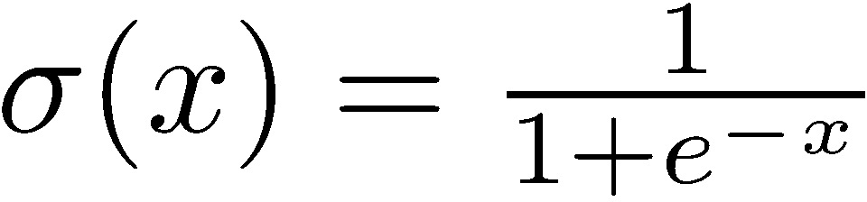
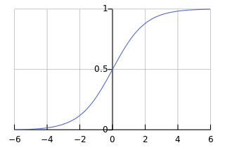
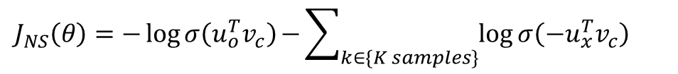
Skip-gram with Negative Sampling
The expensive computation: O(|V|.d)
Let’s see where the complexity is:
Idea: rather than enumerating over all vocabulary, let’s sample!
Maximize the prob that outside word co-occurs w/ the center
Minimize the prob of noise/random words far from the center (negatives)
$$\log{P\left(o\right|c)}=\log{\frac{\exp\left(u_{o}^{T}v_{c}\right)}{\sum_{x∈V}{\exp\left(u_{x}^{T}v_{c}\right)}}}=log\exp\left(u_{o}^{T}v_{c}\right){−\log{\sum_{x∈V}{\exp\left(u_{x}^{T}v_{c}\right)}} }$$
$$J_{NS}\left(θ\right)=−logσ\left(u_{o}^{T}v_{c}\right){−\sum_{k∈\{K samples\}}{\log{σ\left({−u}_{x}^{T}v_{c}\right)}}}$$

Slide 17
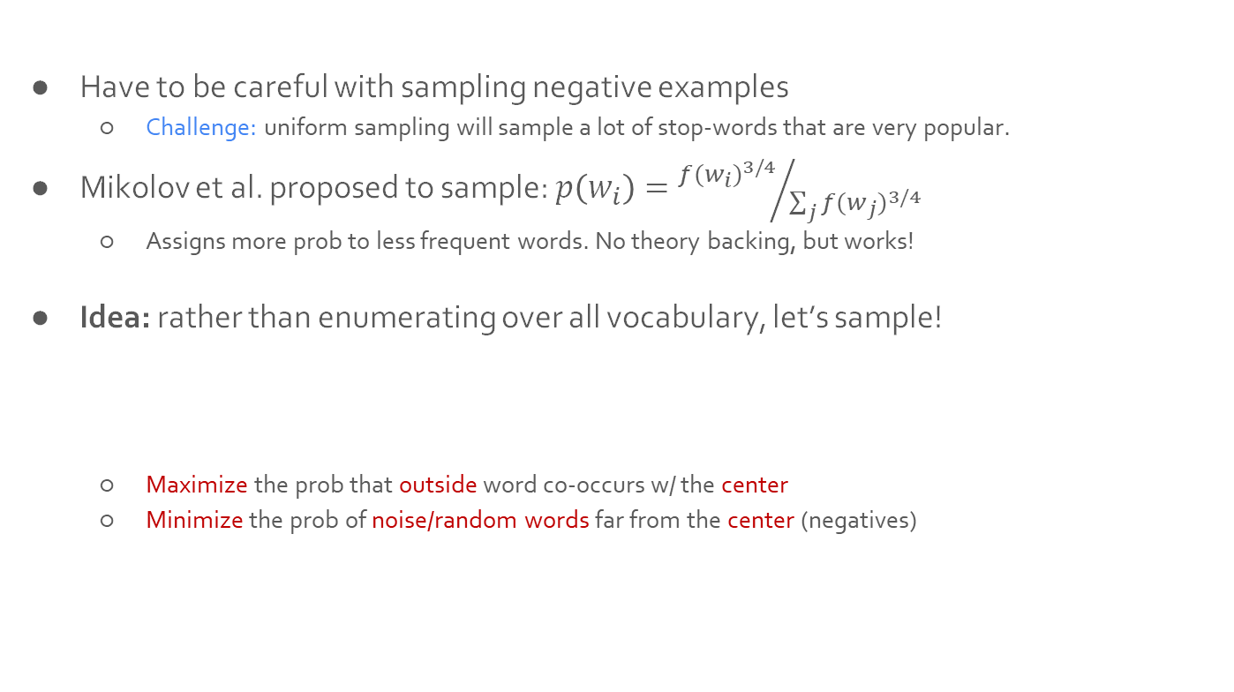
Skip-gram with Negative Sampling (2)
Have to be careful with sampling negative examples
Challenge: uniform sampling will sample a lot of stop-words that are very popular.
Mikolov et al. proposed to sample: $p\left(w_{i}\right)={{f(w_{i})}^{3/4}}/{\sum_{j}{{f(w_{j})}^{3/4}}}$
Assigns more prob to less frequent words. No theory backing, but works!
Idea: rather than enumerating over all vocabulary, let’s sample!
Maximize the prob that outside word co-occurs w/ the center
Minimize the prob of noise/random words far from the center (negatives)
$$J_{NS}\left(θ\right)=−logσ\left(u_{o}^{T}v_{c}\right){−\sum_{k∈\{K samples\}}{\log{σ\left({−u}_{x}^{T}v_{c}\right)}}}$$

Slide 18
Chapter: Self-Supervised Meaning of “Words”: Continued
Human language and word meaning
Word2vec overview
Word2vec objective function and gradients
Inspecting the resulting word vectors
Extrinsic evaluation of word vectors

Slide 19
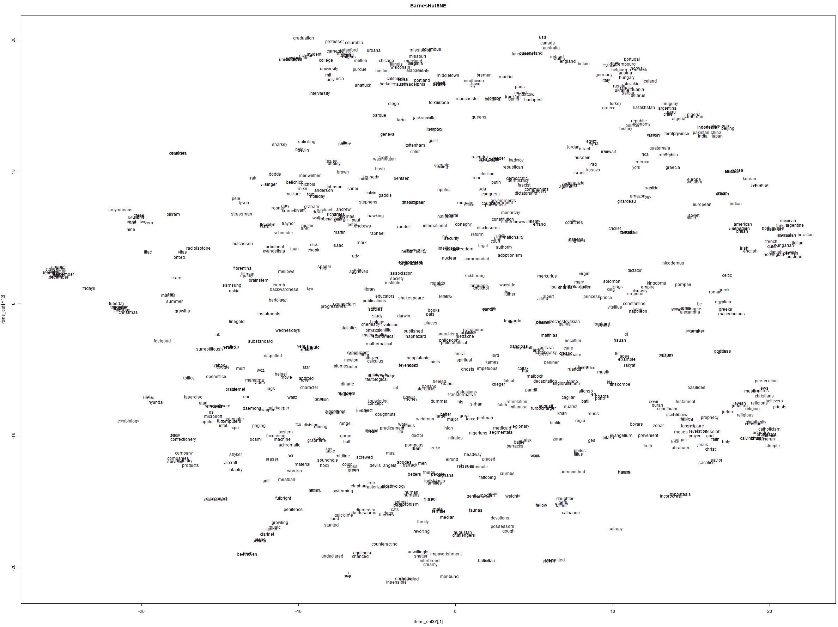
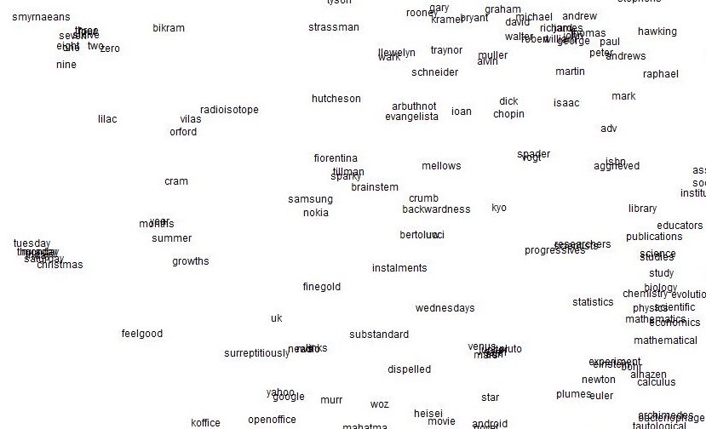
Word2Vec maximizes objective function by putting similar words nearby in space
19

Slide 20
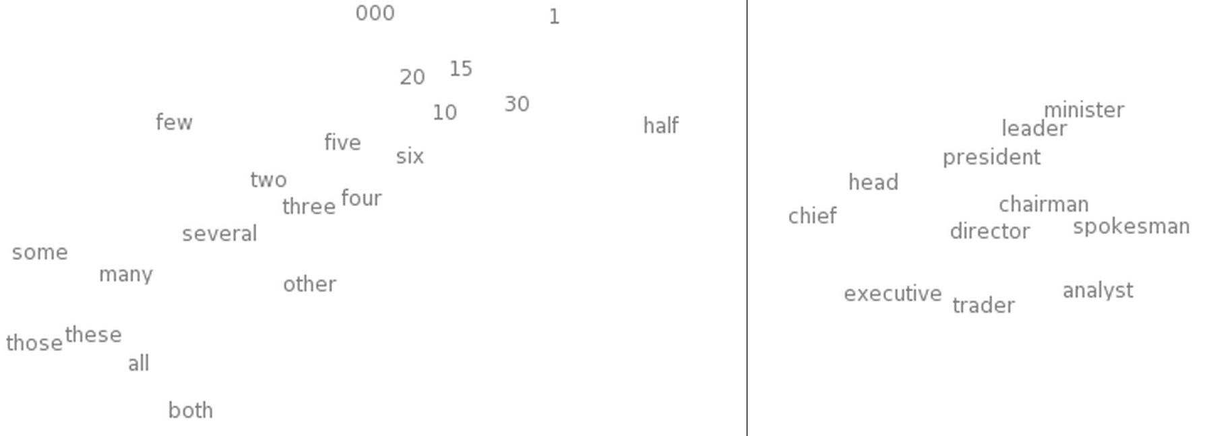
Word2Vec maximizes objective function by putting similar words nearby in space
t-SNE of Word Embeddings
Left: Number Region Right: Jobs Region
Also try: https://projector.tensorflow.org/
[“Deep Learning, NLP, and Representations” by Chris Olah]

Slide 22
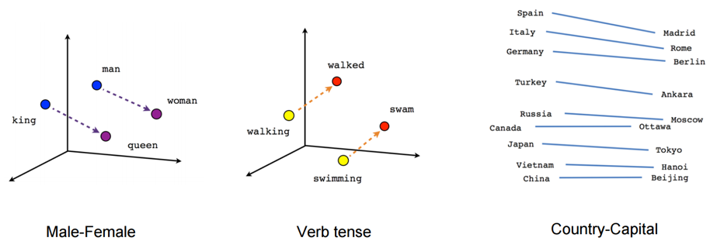
Composition
vec(“woman”)−vec(“man”) ≃ vec(“aunt”)−vec(“uncle”)
vec(“woman”)−vec(“man”) ≃ vec(“queen”)−vec(“king”)
This can be interpreted as “France is to Paris as Italy is to Rome”.
[Linguistic Regularities in Continuous Space Word Representations. Mikolov et al. 2013]

Slide 23
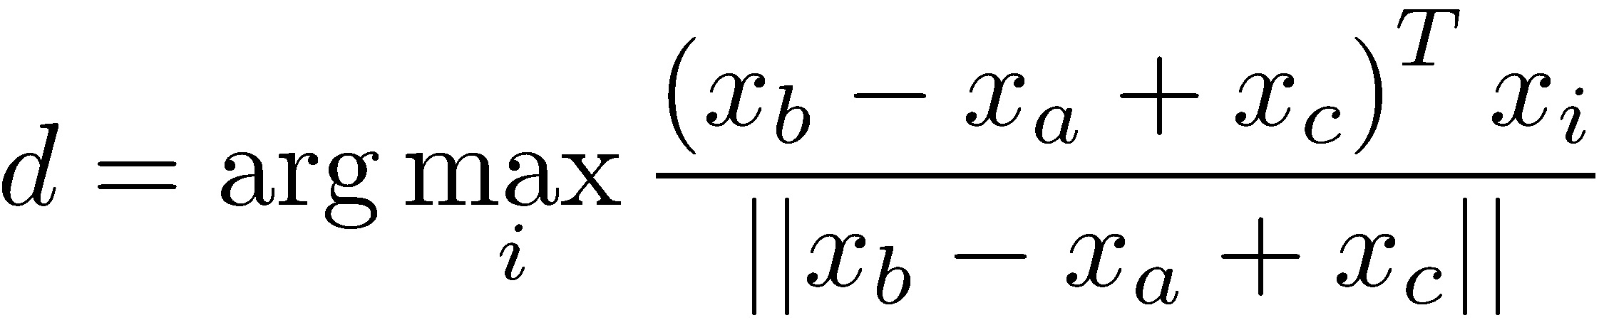

Evaluating Word Vectors: Word Analogies
Composition
Evaluate word vectors by how well their cosine distance after addition captures intuitive analogical relations.
a:b :: c:?
This can be interpreted as “France is to Paris as Italy is to Rome”.
[Linguistic Regularities in Continuous Space Word Representations. Mikolov et al. 2013]

Slide 24
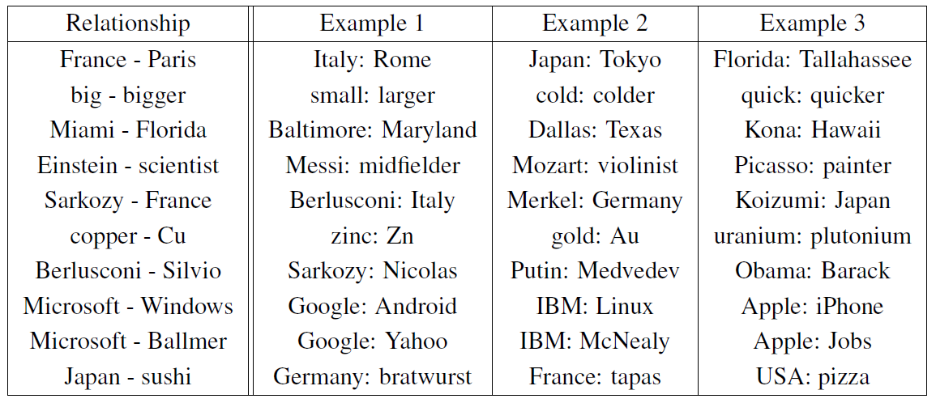
Relations Learned by Word2vec
A relation is defined by the vector displacement in the first column. For each start word in the other column, the closest displaced word is shown.
[Efficient Estimation of Word Representations in Vector Space. Mikolov et al. 2013]

Slide 25
Relations Learned by Word2vec
A relation is defined by the vector displacement in the first column. For each start word in the other column, the closest displaced word is shown.
[Efficient Estimation of Word Representations in Vector Space. Mikolov et al. 2013]

Slide 26
Relations Learned by Word2vec
A relation is defined by the vector displacement in the first column. For each start word in the other column, the closest displaced word is shown.
[Efficient Estimation of Word Representations in Vector Space. Mikolov et al. 2013]

Slide 27
Relations Learned by Word2vec
A relation is defined by the vector displacement in the first column. For each start word in the other column, the closest displaced word is shown.
[Efficient Estimation of Word Representations in Vector Space. Mikolov et al. 2013]

Slide 28
A relation is defined by the vector displacement in the first column. For each start word in the other column, the closest displaced word is shown.
[Efficient Estimation of Word Representations in Vector Space. Mikolov et al. 2013]

Slide 29
A relation is defined by the vector displacement in the first column. For each start word in the other column, the closest displaced word is shown.
[Efficient Estimation of Word Representations in Vector Space. Mikolov et al. 2013]

Slide 30
A relation is defined by the vector displacement in the first column. For each start word in the other column, the closest displaced word is shown.
[Efficient Estimation of Word Representations in Vector Space. Mikolov et al. 2013]

Slide 31
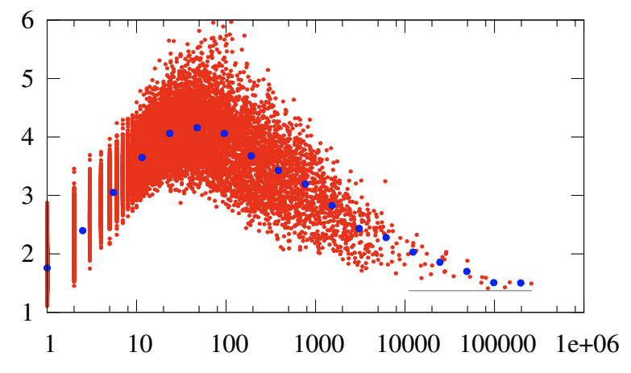
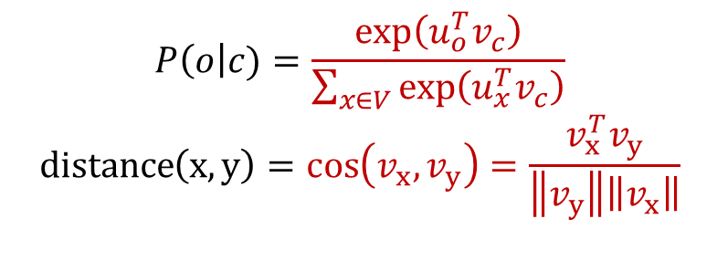
Mismatch Between Cosine and Dot Product
$$P\left(o\right|c)=\frac{\exp\left(u_{o}^{T}v_{c}\right)}{\sum_{x∈V}{\exp\left(u_{x}^{T}v_{c}\right)}}$$
$$\operatorname{distance}\left(x, y\right)=\cos\left(v_{x},v_{y}\right)=\frac{v_{x}^{T}v_{y}}{\left\|v_{y}\right\|\left\|v_{x}\right\|}$$
Observation: there a mismatch between Word2Vec objective and cosine distance!
Why use cosine distance instead of dot product?
Term frequencies affect the embedding norms.
Without normalization, frequent terms would seem more similar.
Why not change W2V objective to not use cos?
¯\_(ツ)_/¯
It’s possible that the resulting vectors would conflate semantic similarity and frequency.
norm
frequency
[Measuring Word Significance using Distributed Representations of Words]

Slide 32
Word2Vec: Variants
Output
Skip-Gram
W₋₂
What we just saw is the Skip-Gram model.
Predict context (“outside”) words (position independent) given center
There is also a CBOW (continuous-bag-of-words) variant.
Predict center word from (bag of) context words
Additional efficiency:
The current gradient computation w/ softmax function is expensive.
Alternative: Negative Sampling
Input
W₋₁
Projection
w₀
w₁
w₂
Input
W₋₂
W₋₁
Output
Sum and projection
w₀
w₁
w₂
Continuous Bag of Words
(CBOW)

Slide 33
Word Embeddings: Big Picture
There are a variety of approaches:
Gradient-based algorithms:
Skip-gram/CBOW (Mikolov et al.), GloVe (Pennington et al.)
NNLM, HLBL, RNN (Bengio et al; Collobert & Weston; Huang et al; Minh & Hinton)
Count-based:
LSA, HAL, COALS, Hellinger-PCA (Lund & Burges; Rohde et al; Lebret & Collobert; Deerwester et al)
Brown clustering (Brown et al.)
Scales with corpus size
Better representations Captures complex patterns
Fast-ish training
Sub-par representations

Slide 34
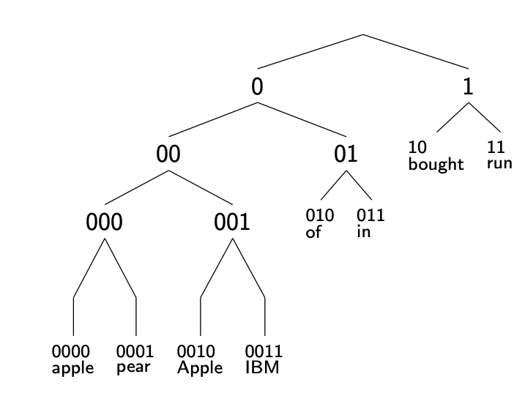
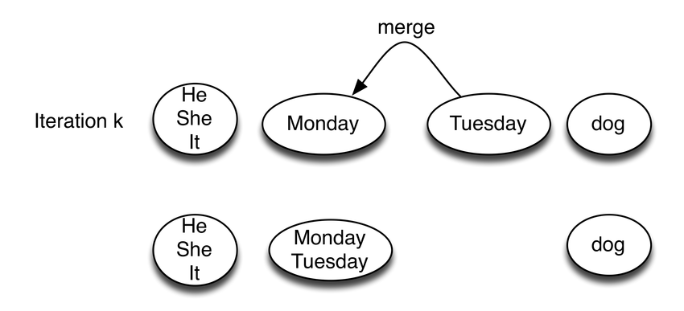
Brown Clusters
Creates a binary tree for all words in a dictionary
Algorithm sketch:
Initialize with isolated nodes (words)
Iteratively merge subtrees, so as to maximize some probabilistic notion of co-occurrence.
Continue until everything connected
Resulting word representation are sequence of 0’s and 1’s connecting a word to the tree root
Note:
Result is hard cluster
Runs in O(|V|^3)
[Class-Based n-gram Models of Natural Language, Brown et al. 1992]

Slide 35
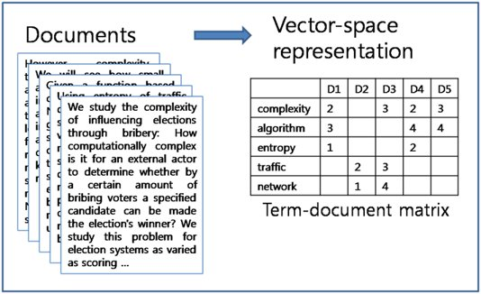
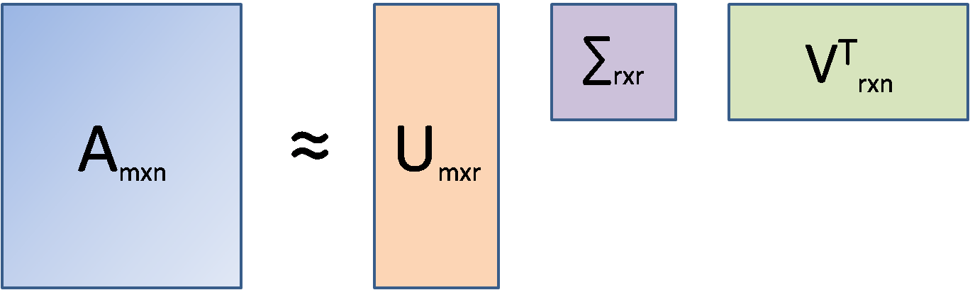
Latent Semantic Analysis
Alg sketch:
Create word-document co-occurrence matrix: each value is the number of appearances of that term in that doc.
Use SVD (or a similar matrix decomposition alg) to create low-dimensional representation for words

Slide 36
Chapter: Self-Supervised Meaning of “Words”: Continued
Human language and word meaning
Word2vec overview
Word2vec objective function and gradients
Inspecting the resulting word vectors
Extrinsic evaluation of word vectors

Slide 37
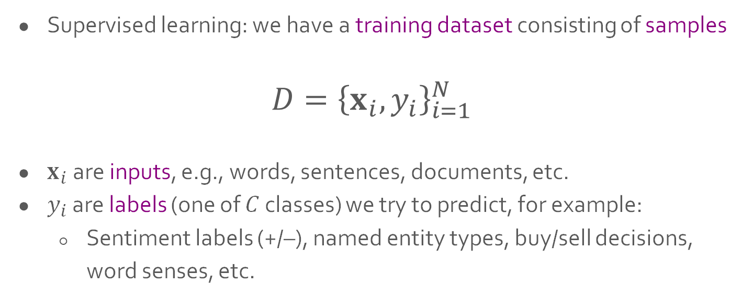
Extrinsic Evaluation of Word Vectors: Classification Recap
Supervised learning: we have a training dataset consisting of samples
$${D=\left\{x_{i}, y_{i}\right\}}_{i=1}^{N}$$
$x_{i}$ are inputs, e.g., words, sentences, documents, etc.
$y_{i}$ are labels (one of $C$ classes) we try to predict, for example:
Sentiment labels (+/–), named entity types, buy/sell decisions, word senses, etc.
Notes:
TODO: convert to math

Slide 38
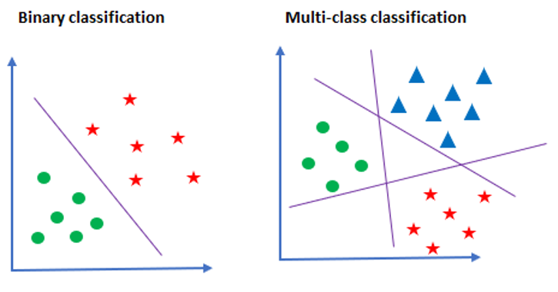
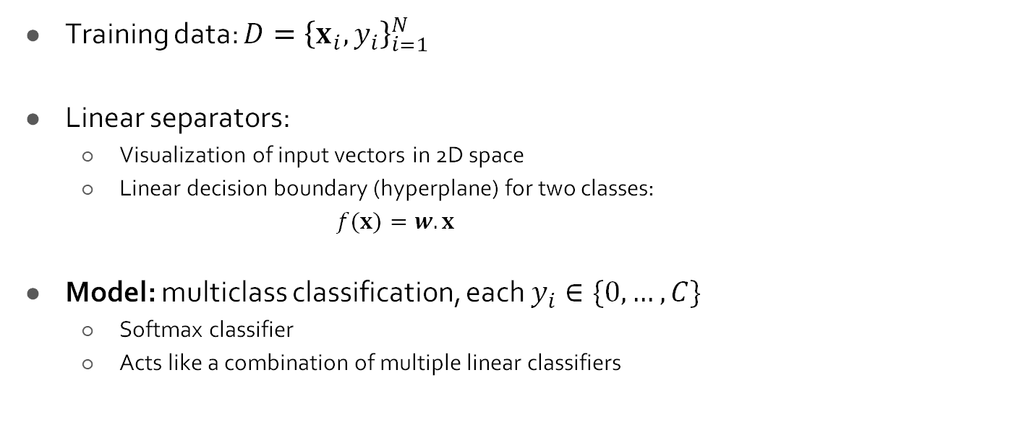
Classification Intuition
Training data: ${D=\left\{x_{i}, y_{i}\right\}}_{i=1}^{N}$
Linear separators:
Visualization of input vectors in 2D space
Linear decision boundary (hyperplane) for two classes:
$f(x)=w.x$
Model: multiclass classification, each $y_{i}∈\{0, …, C\}$
Softmax classifier
Acts like a combination of multiple linear classifiers
Notes:
TODO: convert to math

Slide 39

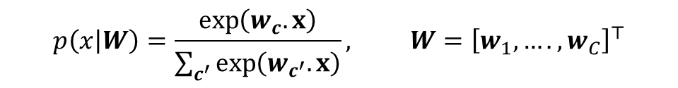

Classification with Softmax Classifier (Logistic Regression)
Compute the score assigned to each class:
${f_{c}(x)=w}_{c}.x ∀c∈C$ and parameters: $W={\left[w_{1}, ….,w_{C}\right]}^{⊤}∈ℝ^{C×d}$
2. Pass them through the Softmax to get probabilities:
Putting it together:
Note: during inference we can just pick the class with the highest score $\hat{y}= {argmax}_{c∈C}w_{c}.x$
$$σ{\left(z\right)}_{i}=\frac{\exp\left(z_{i}\right)}{\sum_{j}{\exp\left(z_{j}\right)}}, z=[z_{1}, ….,z_{C}]$$
$$p\left(x | W\right)=\frac{\exp\left(w_{c}.x\right)}{\sum_{c^{′}}{\exp\left(w_{c^{′}}.x\right)}}, W={\left[w_{1}, ….,w_{C}\right]}^{⊤}$$

Slide 40
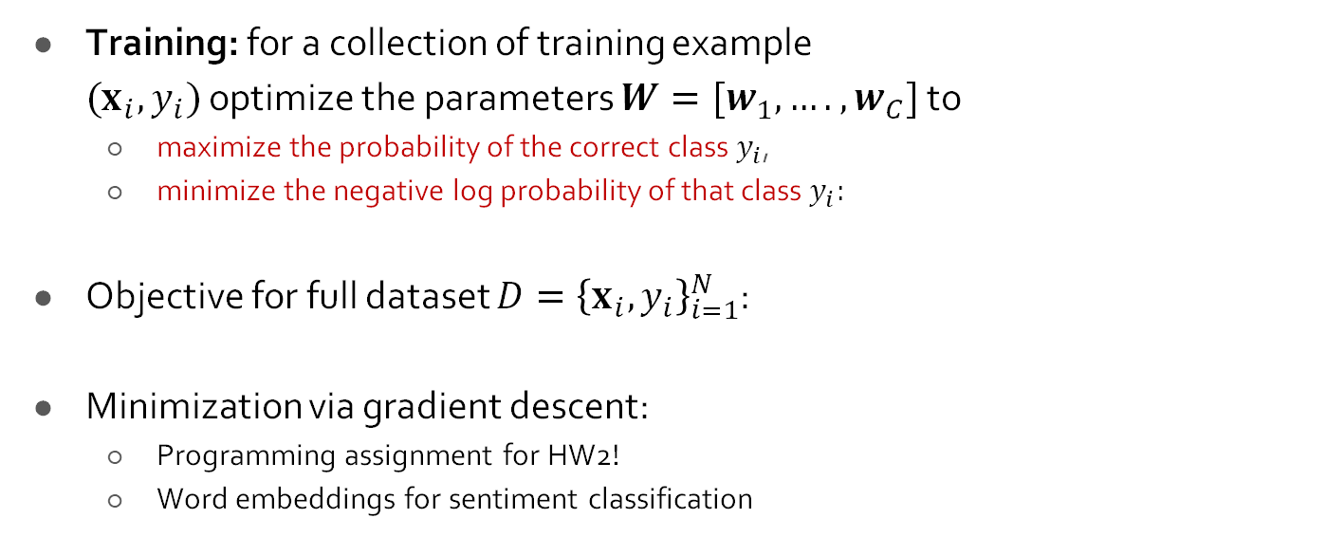

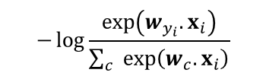

Classification with Softmax Classifier (Logistic Regression)
Training: for a collection of training example ${(x}_{i}, y_{i})$ optimize the parameters $W=[w_{1}, ….,w_{C}]$ to
maximize the probability of the correct class $y_{i}$,
minimize the negative log probability of that class $y_{i}:$
Objective for full dataset ${D=\left\{x_{i}, y_{i}\right\}}_{i=1}^{N}$:
Minimization via gradient descent:
Programming assignment for HW2!
Word embeddings for sentiment classification
$$−\log{\frac{\exp\left(w_{y_{i}}.x_{i}\right)}{\sum_{c}{\exp\left(w_{c}.x_{i}\right)}}}$$
$$J\left(W\right)=\frac{1}{N}\sum_{i}{−\log{\frac{\exp\left(w_{y_{i}}.x_{i}\right)}{\sum_{c}{\exp\left(w_{c}.x_{i}\right)}}}}$$
$$∇_{W}J\left(W\right)=\left[\begin{matrix}∇_{w_{1}} \\ ⋮ \\ ∇_{w_{C}}\end{matrix}\right] ∈ℝ^{C×d}$$

Slide 41
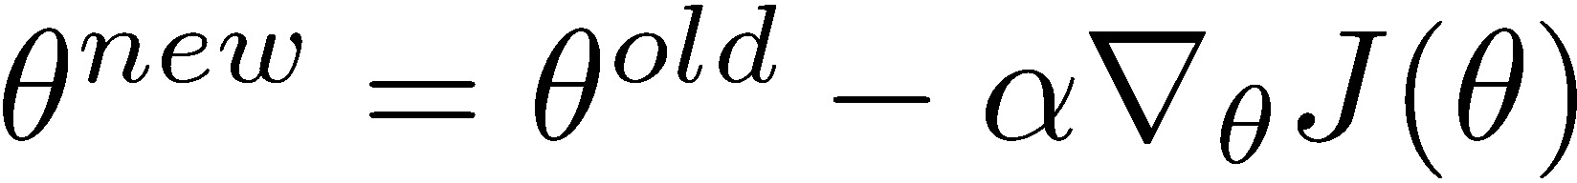
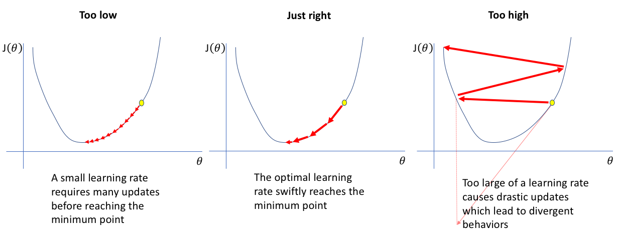
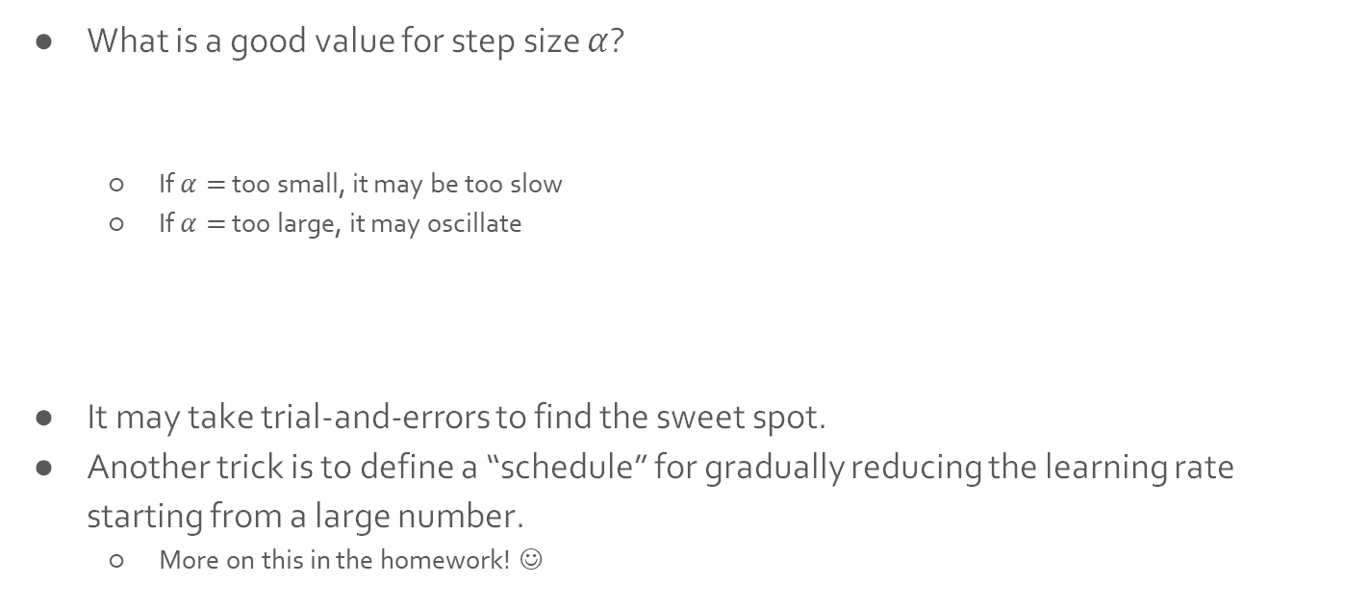
Aside: Setting the Step Size in Gradient Descent
What is a good value for step size $α$?
If $α=$ too small, it may be too slow
If $α=$ too large, it may oscillate
It may take trial-and-errors to find the sweet spot.
Another trick is to define a “schedule” for gradually reducing the learning rate starting from a large number.
More on this in the homework! ☺
[figure from: https://www.jeremyjordan.me/nn-learning-rate/]

Slide 42

Limitations of Word Embeddings: Lack of Compositionality
Lexical and Compositional Semantics
Lexical Semantics: focuses on the meaning of individual words.
Compositional Semantics: meaning depends on the words, and on how they are combined.

Slide 43
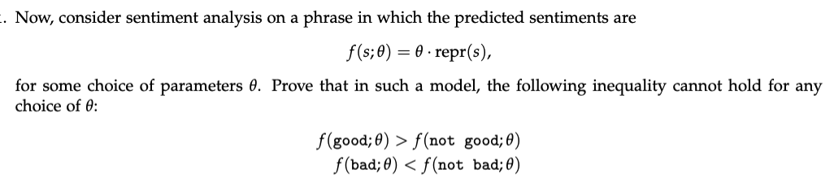
Limitations of Word Embeddings: Lack of Compositionality
Lexical and Compositional Semantics
Lexical Semantics: focuses on the meaning of individual words.
Compositional Semantics: meaning depends on the words, and on how they are combined.
From HW:

Slide 44
Limitations of Word Embeddings: No Word Senses
Most words have lots of meanings!
Especially common words
Or those that existed for a long time
Example: “bear”
Do word vectors capture word senses?
A mammal (🐻)
Something difficult (the oven is a bear to clean)
To accept (couldn’t bear the pain)
To have features (bears a likeness of her mom)
To contain (old-bearing shale)
To hold in mind or emotions (bear malice)
…
Notes:
TODO: add example sentences for each sense; or some of them

Slide 45
Today’s Recap
W2V training and broader family of word embeddings
Building classifiers with word embeddings
Next time: moving beyond words by modeling sequences.

